Slide 1
AWS Amplify
Lecturer: Ngo Huy Bien
Software Engineering Department
Faculty of Information Technology
University of Science
Ho Chi Minh City, Vietnam
nhbien@fit.hcmus.edu.vn

Slide 2

Objectives

Slide 3

Contents

Slide 4

References

Slide 5
AWS Amplify
https://aws.amazon.com/amplify/
Amplify is everything you need to build full-stack web and mobile apps on AWS.
Build and host your frontend, add features like auth and storage, connect to real-time data sources, deploy, and scale to millions of users.

Slide 6
Why AWS Amplify?
Build cloud-connected UI
Connect your app to data
Add Authentication and Authorization
Store and manage app content and data
Fully managed CI/CD and hosting

Slide 7
Amplify Framework [1]
The Amplify Framework is a combination of four things: CLI, client library, toolchain, and web-hosting platform.
Amplify’s purpose is to provide an easy way for developers to build and deploy full stack web and mobile applications that leverage the cloud.
It enables not only features such as serverless functions and authentication, but also GraphQL APIs, machine learning (ML), storage, analytics, push notifications, and more.

Slide 8
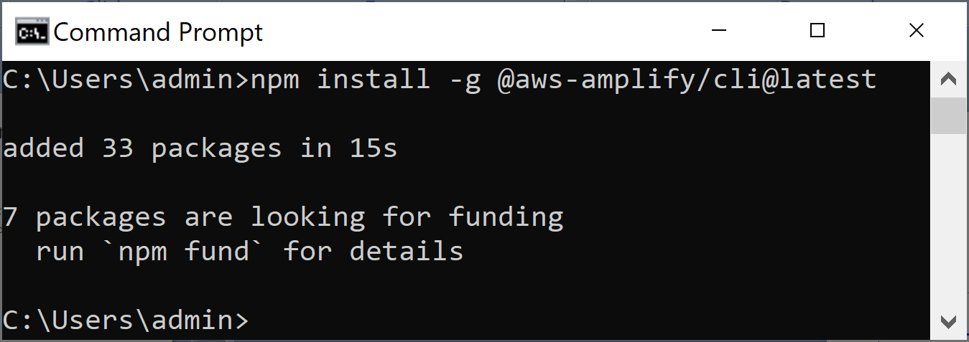
1. Install AWS Amplify CLI
https://ui.docs.amplify.aws/react/connected-components/authenticator
npm install -g @aws-amplify/cli@latest

Slide 9
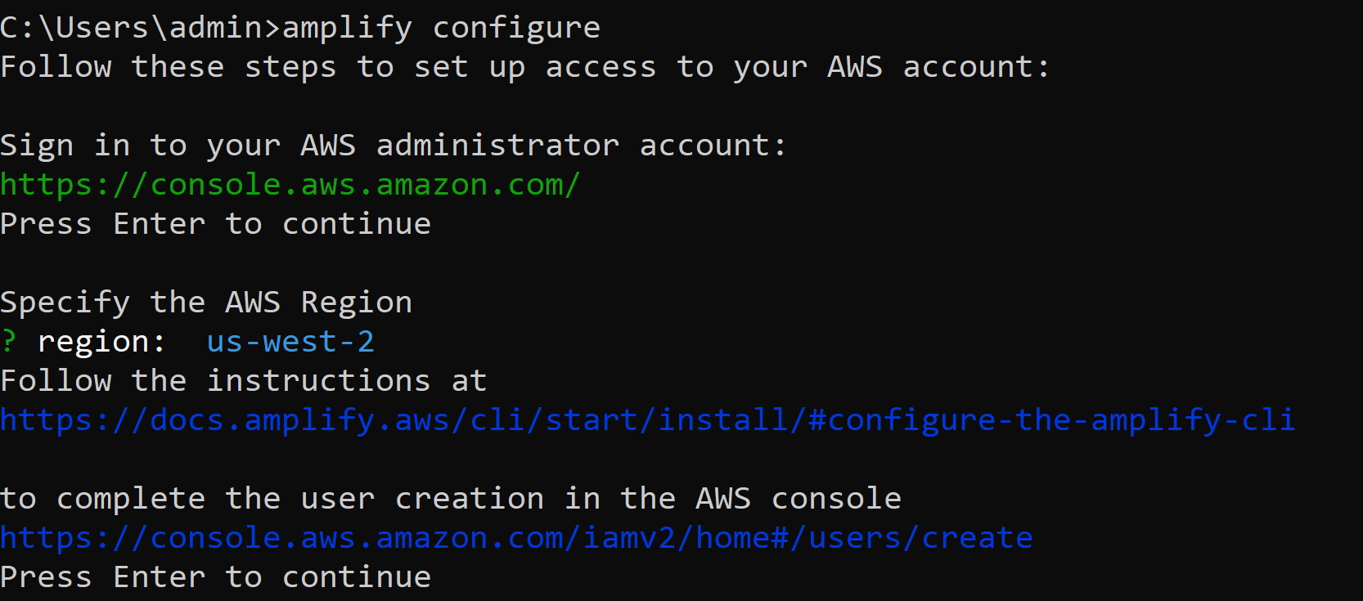
2. Configure the Amplify CLI
amplify configure

Slide 10
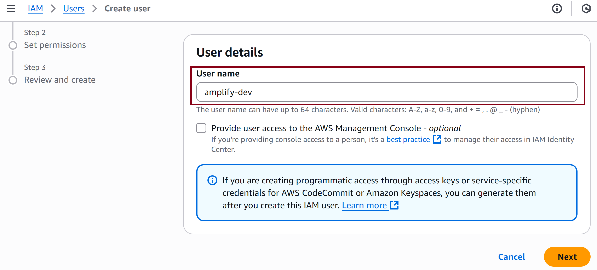
3. Create IAM User

Slide 11
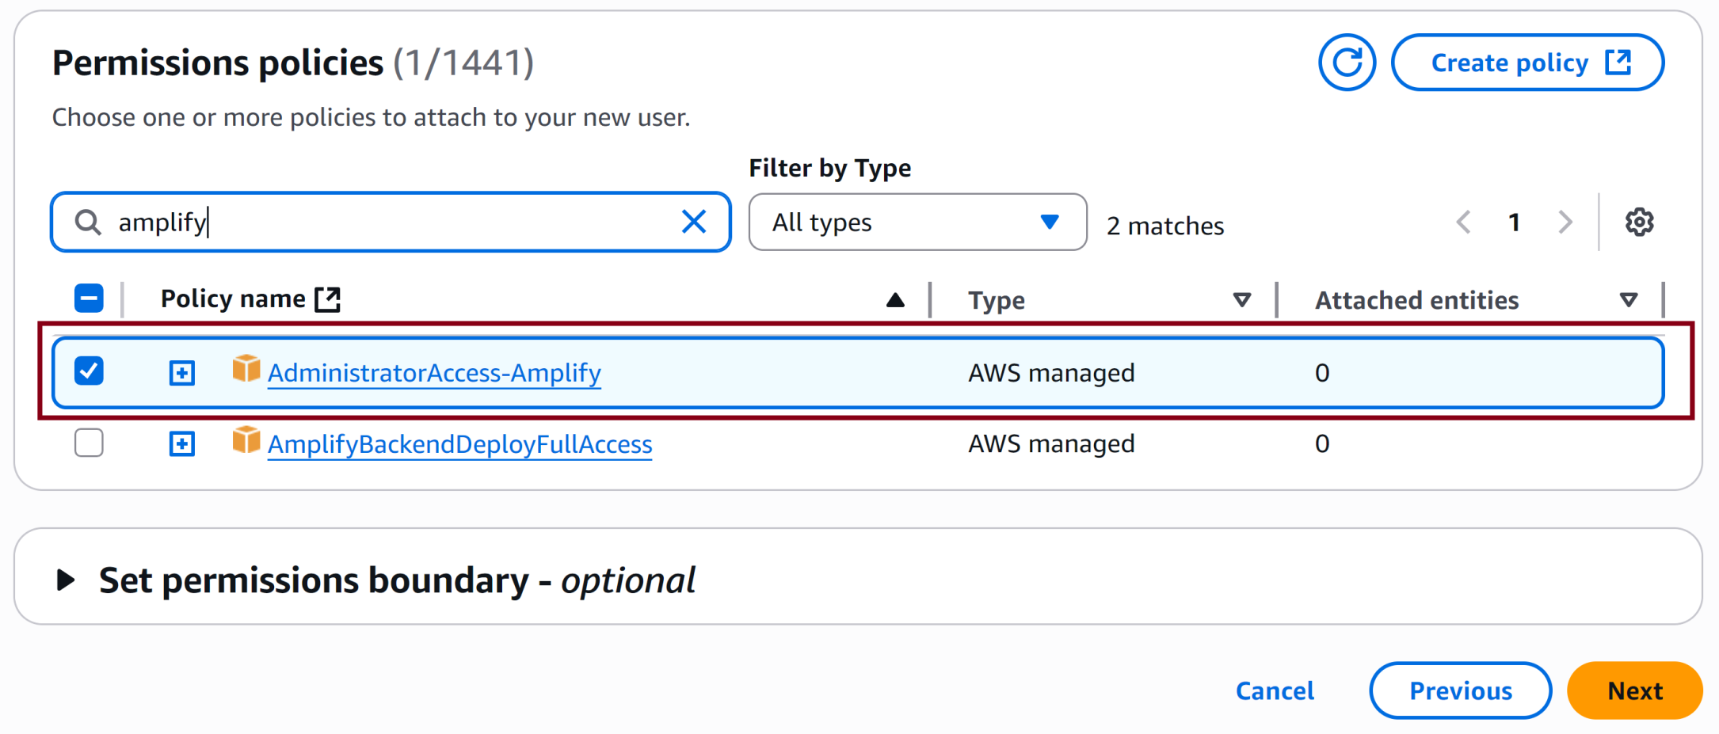
4. Select Policy

Slide 12
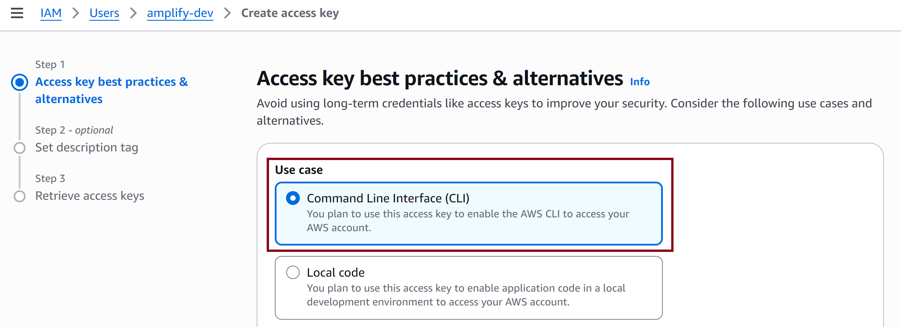
5. Create Access Key

Slide 13
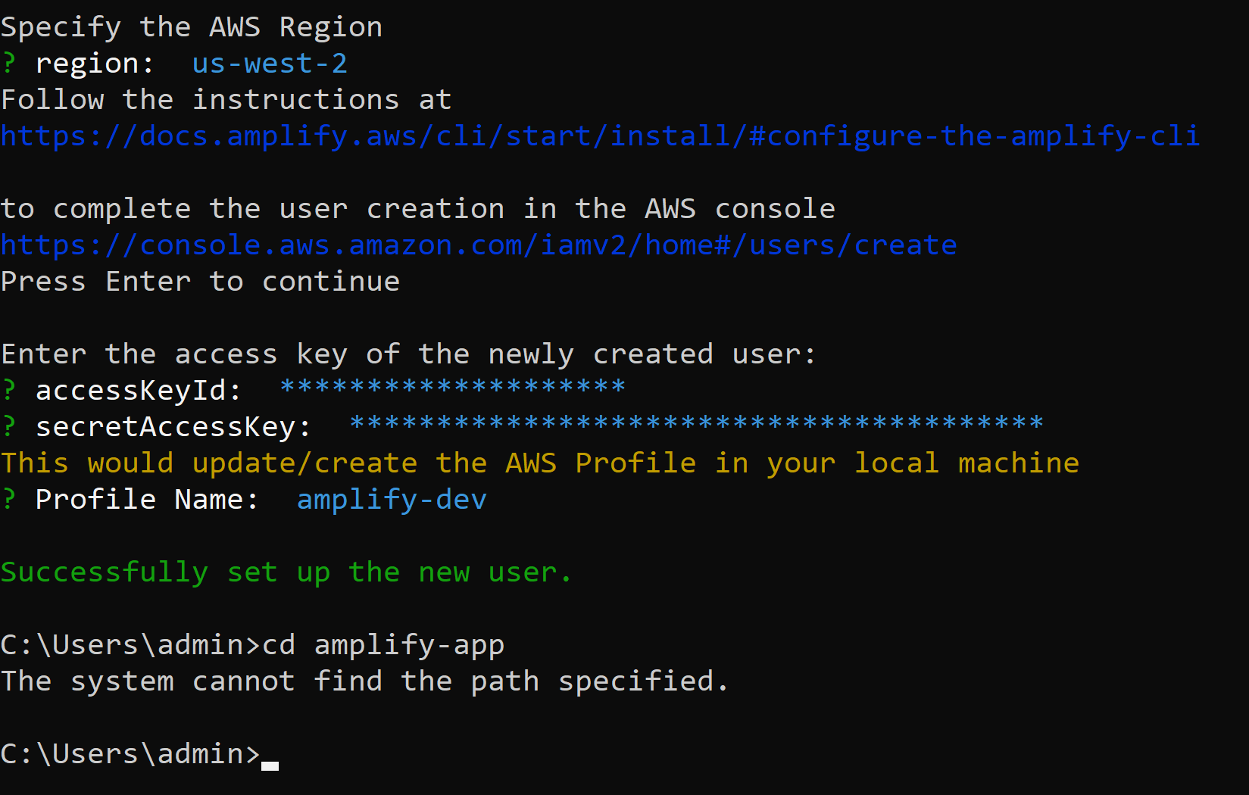
6. Enter the Access Key

Slide 14


Slide 15
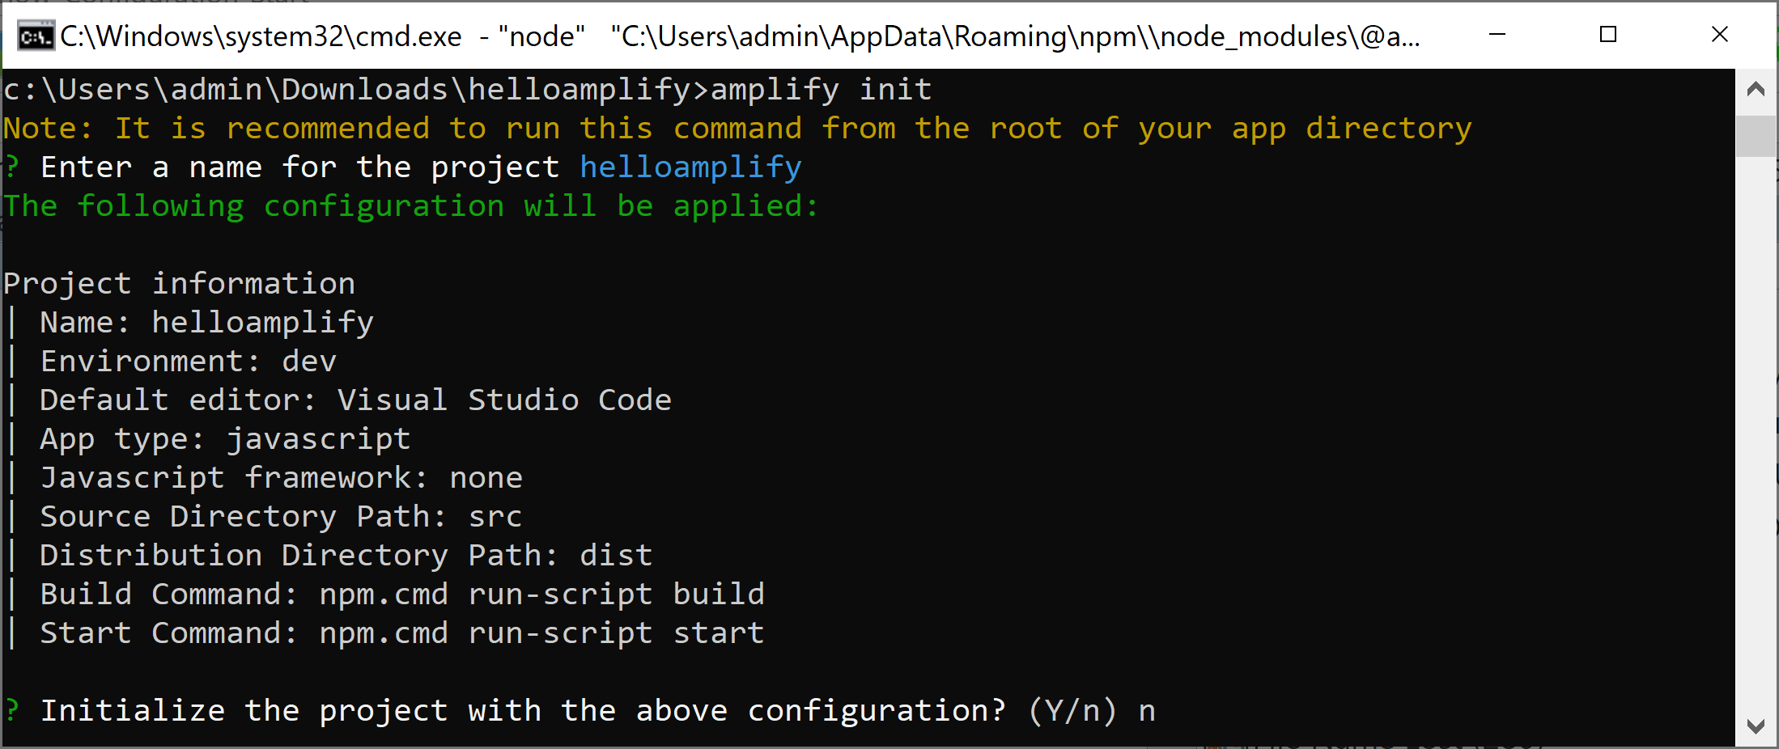
1. Helo Amplify
amplify init

Slide 16
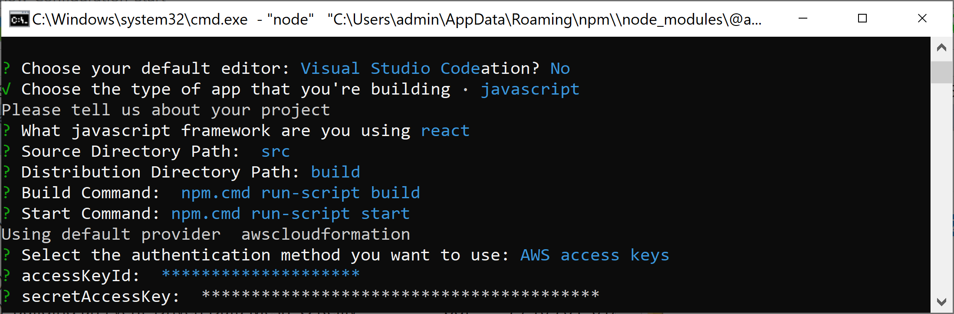
2. Set Up the Project Info

Slide 17
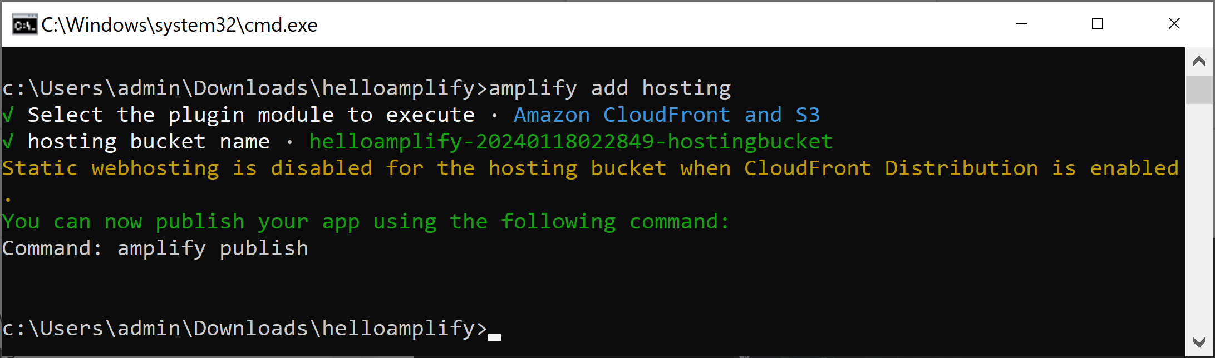
3. Add App Hosting
amplify add hosting

Slide 18
4. Publish the App
amplify publish

Slide 19

Thank You & See You Again

